Slide 1
System Calls, fork(), exec()
Event Driven Kernel,
Multi-tasking OS
Abhijit A. M.
abhijit.comp@coep.ac.in
(C) Abhijit A.M.
Available under Creative Commons Attribution-ShareAlike License V3.0+
Credits: Slides of “OS Book” ed10.

Slide 2
Building an “OS”
E.g. Debian
  A collection of thousands of applications, libraries, system programs, ... and Linux kernel !
  Linux kernel is at the heart, but heart is not a human without the body !
  Job of “Debian Developers”
    Collect the source code of all things you want
    Create an “Environment” for compiling things : bootstrap challenge
    Compile everything
    Ensure that things work “with each other”
      Very difficult! Versions, dependencies !
    “Package” things (e.g. make .deb files )

Slide 3


Slide 4

Components of a computer system
Abstract view

Slide 5

Von Neumann architecture
Processor
  Fetch
  Decode
  Execute
  Repeat
A von Neumann architecture

Slide 6
A key to “understanding”
Everything happens on processor
Processor is always running some instruction
We should be able to tell possible execution sequences on processor

Slide 7
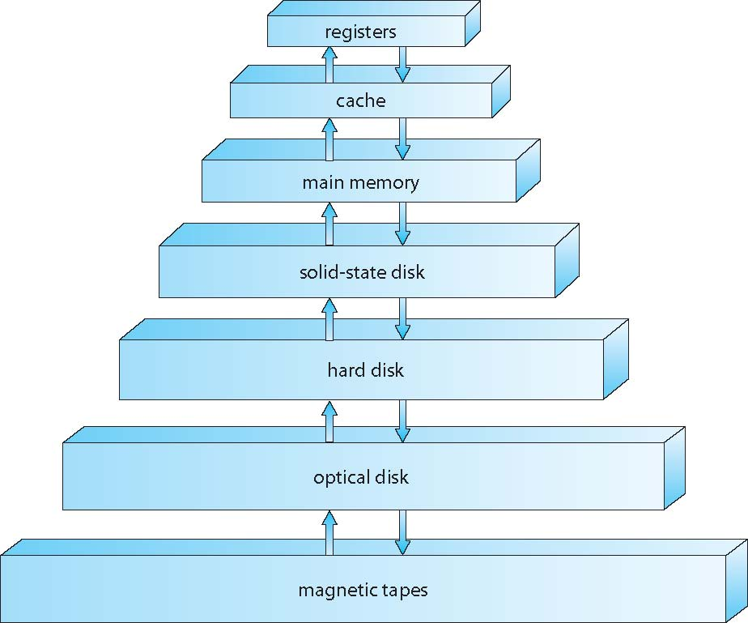
Memory hierarchy

Slide 8
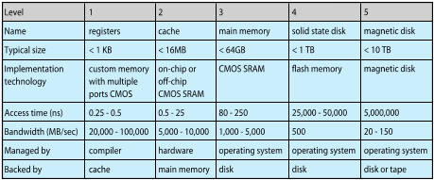
Memory hierarchy

Slide 9
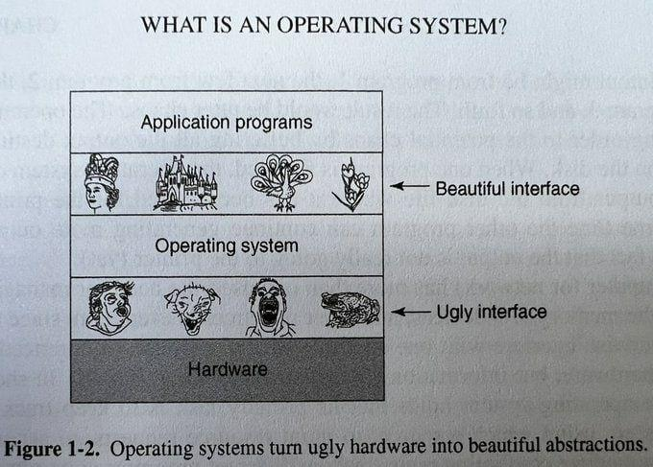

Slide 10
System Calls
Services provided by operating system to applications
  Essentially available to applications by calling the particular software interrupt application
    All system calls essentially involve the “INT 0x80” on x86 processors + Linux
    Different arguments specified in EAX register inform the kernel about different system calls
The C library has wrapper functions for each of the system calls
  E.g. open(), read(), write(), fork(), mmap(), etc.

Slide 11
Types of System Calls
File System Related
  Open(), read(), write(), close(), etc.
Processes Related
  Fork(), exec(), ...
Memory management related
  Mmap(), shm_open(), ...
Device Management
Information maintainance – time,date
Communication between processes (IPC)
Read man syscalls
https://linuxhint.com/list_of_linux_syscalls/

Slide 12


Slide 13
Code schematic
int main() {
int a = 2;
printf("hi\n");
}
-----
C Library
-----
int printf("void *a, ...) {
...
write(1, a, ...);
}
int write(int fd, char *, int len) {
int ret;
...
mov $5, %eax,
mov ... %ebx,
mov ..., %ecx
int $0x80
__asm__("movl %eax, -4(%ebp)");
# -4ebp is ret
return ret;
}
-------user-kernel-mode-boundary----
//OS code
int sys_write(int fd, char *, int len) {
figure out location on disk
where to do the write and
carry out the operation,
etc.
}

Slide 14


Slide 15
Two important system calls
Related to processes
fork() and exec()

Slide 16
Process
A program in execution
Exists in RAM
Scheduled by OS
  In a timesharing system, intermittantly scheduled by allocating a time quantum, e.g. 20 microseconds
The “ps” command on Linux

Slide 17
Process in RAM
Memory is required to store the following components of a process
  Code
  Global variables (data)
  Stack (stores local variables of functions)
  Heap (stores malloced memory)
  Shared libraries (e.g. code of printf, etc)
  Few other things, may be

Slide 18

MS-DOS: a single tasking operating system
Only one program in RAM at a time, and only one program can run at a time

Slide 19

A multi tasking system
With multiple programs loaded in memory
Along with kernel
(A very simplified conceptual diagram. Things are more complex in reality)

Slide 20
fork()
A running process creates it’s duplicate!
After call to fork() is over
  Two processes are running
  Identical
  The calling function returns in two places!
  Caller is called parent, and the new process is called child
  PID is returned to parent and 0 to child

Slide 21
exec()
Variants: execvp(), execl(), etc.
Takes the path name of an executable as an argument
Overwrites the existing process using the code provided in the executable
The original process is OVER ! Vanished!
The new program starts running overwritting the existing process!

Slide 22
Let's Understand fork() and exec()
#include <unistd.h>
int main() {
fork();
printf("hi\n");
return 0;
}
#include <unistd.h>
int main() {
printf("hi\n");
execl("/bin/ls", "ls", NULL);
printf("bye\n");
return 0;
}

Slide 23
A simple shell
#include <stdio.h>
#include <unistd.h>
int main() {
char string[128];
int pid;
while(1) {
printf("prompt>");
scanf("%s", string);
pid = fork();
if(pid == 0) {
execl(string, string, NULL);
} else {
wait(0);
}
}
}

Slide 24
Shell using fork and exec
Demo
The only way a process can be created on Unix/Linux is using fork() + exec()
All processes that you see were started by some other process using fork() + exec() , except the initial “init” process
When you click on “firefox” icon, the user-interface program does a fork() + exec() to start firefox; same with a command line shell program
The “bash” shell you have been using is nothing but an advanced version of the shell code shown during the demo
See the process tree starting from “init”
Your next assignment

Slide 25
The boot process
BIOS/UEFI
  The firmware. Runs “Automatically”.
  CPU is hardwired to start running instructions stored a a fixed address.
  The Motherboard manufacturers, ensure that the BIOS/UEFI is at his address
Boot loader
  BIOS reads the code from sector 0 of the “Boot device”, this is called “Boot Loader”, and loads it in RAM
  PC changed to Boot Loader code
  GRUB is an example
kernel
  The Boot Loader shows the choice of running an OS, user selects a choice
  The Boot loader loads the code of kernel from disk into RAM
  PC changed to kernel code
Kernel initializes hardware, it’s own data structures, etc etc
Init created by kernel by Hand
Kernel schedules init (the only process)
Init fork-execs some programs (user mode)
  Now these programs will be scheduled by OS
Init -> GUI -> terminal -> shell
  One of the typical parent-child relationships

Slide 26
Event Driven kernel
Multi-tasking, Multi-programming

Slide 27
Earlier...
Boot process
  BIOS -> Boot Loader -> OS -> “init” process
CPU doing
  for(;;) {
    fetch from @PC;
    deode+execute;
    PC++/change PC
  }

Slide 28
Understanding hardware interrupts
Hardware devices (keyboard, mouse, hard disk, etc) can raise “hardware interrupts”
Basically create an electrical signal on some connection to CPU (/bus)
This is notified to CPU (in hardware)
Now CPU’s normal execution is interrupted!
  What’s the normal execution?
  CPU will not continue doing the fetch, decode, execute, change PC cycle !
  What happens then?

Slide 29
Understanding hardware interrupts
On Hardware interrupt
  The PC changes to a location pre-determined by CPU manufacturers!
  Now CPU resumes normal execution
    What’s normal?
    Same thing: Fetch, Decode, Execute, Change PC, repeat!
    But...
  But what’s there at this pre-determined address?
  OS! How’s that ?(in a few minutes)

Slide 30
IVT
Location1
Location2
Location3
...
Location_n
mov 100, r1
add r1, 1
mov r1, 200
cmp r1, r2
jnz 3000
add r1, r2
mov 100, r1
add r1, 1
mov r1, 200
cmp r1, r2
jnz 3000
add r1, r2
mov 100, r1
add r1, 1
mov r1, 200
cmp r1, r2
jnz 3000
add r1, r2
PC
Location3: ISR
mov 100, r1
add r1, 1
mov r1, 200
cmp r1, r2
jnz 3000
add r1, r2
PC
Interrupt

Slide 31
Boot Process
BIOS runs “automatically” because at the initial value of PC (on power ON), the manufacturers have put in the BIOS code in ROM
  CPU is running BIOS code . BIOS code also occupies all the addresses corresponding to hardware interrupts.
BIOS looks up boot loader (on default boot device) and loads it in RAM, and passes control over to it
  Pass control? - Like a JMP instruction
  CPU is running boot loader code
Boot loader gets boot option from human user, and loads the selected OS in memory and passes control over to OS
  Now OS is running on the processor !

Slide 32
Hardware interrupts and OS
When OS starts running initially
  It copies relevant parts of it’s own code at all possible memory addresses that a hardware interrrupt can lead to!
  If there is an IVT in the hardware, OS sets up the IVT also!
  Intelligent, isnt’ it?
Now what?
  Whenever there is a hardware interrupt – what will happen?
  The PC will change to predetermined location, and control will jump into OS code
So remember: whenever there is a hardware interrupt, OS code will run!
This is “taking control of hardware”

Slide 33
Key points
Understand the interplay of hardware features + OS code + clever combination of the two to achieve OS control over hardware
Most features of computer systems / operating systems are derived from hardware features
  We will keep learning this throught the course
  Hardware support is needed for many OS features

Slide 34
Time Shared CPU
Timesharing happens after the OS has been loaded and Desktop environment is running
The OS and different application programs keep executing on the CPU alternatively (more about this later)
  The CPU is time-shared between different applications and OS itself
How is this done?
  kernel sets up the “timer register”
  kernel changes PC to address of a process (now process runs)
    Timer register decremented automatically in hardware
  When timer is “up”, a hardware interrupt occurs!
  Now OS runs again! This OS code is called “scheduler”

Slide 35
Multiprogramming
Program
  Just a binary (machine code) file lying on the hard drive. E.g. /bin/ls
  Does not do anything!
Process
  A program that is executing
  Must exist in RAM before it executes. Exec() does this.
  One program can run as multiple processes. What does that mean?

Slide 36
Multiprogramming
Multiprogramming
  A system where multiple processes(!) exist at the same time in the RAM
  But only one runs at a time!
    Because there is only one CPU
Multi tasking
  Time sharing between multiple processes in a multi-programming system
  Timer interrupt used to achieve this.

Slide 37
Question
Select the correct one
  1) A multiprogramming system is not necessarily multitasking
  2) A multitasking system is not necessarily multiprogramming

Slide 38
Events , that interrupt CPU’s functioning
Three types of “traps” : Events that make the CPU run code at a pre-defined address (given by IVT)
  1) Hardware interrupts
  2) Software interrupt instructions (trap)
    E.g. instruction “INT”
  3) Exceptions
    e.g. a machine instruction that does division by zero
    Illegal instruction, etc.
    Some are called “faults”, e.g. “page fault”, recoverable
    some are called “aborts”, e.g. division by zero, non-recoverable
The kernel code occupies all memory locations corresponding to the PC values related to all the above events, at the time of boot! It also sets up the IVT if there is one.

Slide 39
Multi tasking requirements
Two processes should not be
  Able to steal time of each other
  See data/code of each other
  Modify data/code of each other
  Etc.
The OS ensures all these things. How?
  To be seen later.

Slide 40
But the OS is “always” “running”
“in the background”
Isn’t it?
Absolutely No!

Slide 41
Let’s understand
What kind of
Hardware, OS interplay
makes
Multitasking possible

Slide 42
Two types of CPU instructions and two modes of CPU operation
CPU instructions can be divided into two types
Normal instructions
  mov, jmp, add, etc.
Privileged instructions
  Normally related to hardware devices
  E.g.
    IN, OUT # write to I/O memory locations
    INTR # software interrupt, etc.

Slide 43
Two types of CPU instructions and two modes of CPU operation
CPUs have a mode bit (can be 0 or 1)
The two values of the mode bit are called: User mode and Kernel mode
If the bit is in user mode
  Only the normal instructions can be executed by CPU
If the bit is in kernel mode
  Both the normal and privileged instructions can be executed by CPU
If the CPU is “made” to execute privileged instruction when the mode bit is in “User mode”
  It results in a illegal instruction execution
  Again jumping to kernel code, using IVT!

Slide 44
Two types of CPU instructions and two modes of CPU operation
The opearting system code runs in kernel mode.
  How? Wait for that!
The application code runs in user mode
  How? Wait !
  So application code can not run privileged hardware instructions
Transition from user mode to kernel mode and vice-versa
  Special instruction called “software interrupt” instructions
  E.g. INT instruction on x86

Slide 45
Software interrupt instruction
E.g. INT on x86 processors
Does two things at the same time!
  Changes mode from user mode to kernel mode in CPU
  + Jumps to a pre-defined location! Basically changes PC to a pre-defined value.
    Close to the way a hardware interrupt works. Isn’t it?
  Why two things together?
  What’s there are the pre-defined location?
    Obviously, OS code. OS occupied these locations in Memory, at Boot time.

Slide 46
Software interrupt instruction
What’s the use of these type of instructions?
  An application code running INT 0x80 on x86 will now cause
    Change of mode
    Jump into OS code
  Effectively a request by application code to OS to do a particular task!
  E.g. read from keyboard or write to screen !
  OS providing hardware services to applications !

Slide 47
Code schematic
int main() {
int a = 2;
printf("hi\n");
}
-----
C Library
-----
int printf("void *a, ...) {
...
write(1, a, ...);
}
int write(int fd, char *, int len) {
int ret;
...
mov $5, %eax,
mov ... %ebx,
mov ..., %ecx
int $0x80
__asm__("movl %eax, -4(%ebp)");
# -4ebp is ret
return ret;
}
-------user-kernel-mode-boundary----
//OS code
int sys_write(int fd, char *, int len) {
figure out location on disk
where to do the write and
carry out the operation,
etc.
}

Slide 48


Slide 49
Software interrupt instruction
How does application code run INT instruction?
  C library functions like printf(), scanf() which do I/O requests contain the INT instruction!
  Control flow
    Application code -> printf -> INT -> OS code -> back to printf code -> back to application code

Slide 50
Example: C program
int main() {
int i, j, k;
k = 20;
scanf("%d", &i); // This jumps into OS and returns back
j = k + i;
printf("%d\n", j); // This jumps into OS and returns back
return 0;
}

Slide 51
Interrupt driven OS code
OS code is sitting in memory , and runs intermittantly . When?
  On a software or hardware interrupt or exception!
  Event/Interrupt driven OS!
  Hardware interrupts and exceptions occur asynchronously (un-predictedly) while software interrupts are caused by application code

Slide 52
Interrupt driven OS code
Timer interrupt and multitasking OS
  Setting timer register is a privileged instruction.
  After setting a value in it, the timer keeps ticking down and on becoing zero the timer interrupt is raised again (in hardware automatically)
  OS sets timer interrupt and “passes control” over to some application code. Now only application code running on CPU !
  When time allocated to process is over, the timer interrupt occurs and control jumps back to OS (hardware interrupt mechanism)
  The OS code that runs here (the ISR) is called “scheduler”
  OS can now schedule another program

Slide 53

What runs on the processor ?
4 possibilities.

